Slide 1



Meta Communication Library
2021-02-18

Slide 2
Overview
Communication with robot
Support
Dobot
Janome Desktop JR3000 and JC-3
Automatically generate interface and GUI to control supported robots

Slide 3
Structure
Apply “Abstract factory” pattern to design software
Services communicate with each other via interface
Support multiple-axis robot (XY, XYZ, XYR, XYZR)
Real-time updated status (current position)
Support JOG function and PTP function

Slide 4
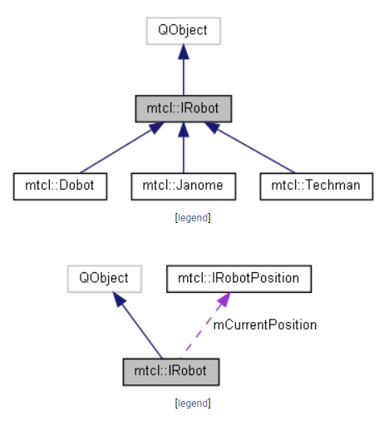
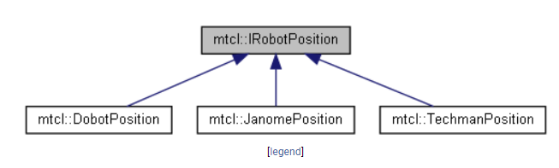
Structure
IRobot: interface of Robot
Concrete Robot included: Dobot, Janome and Techman
IRobotPosition: interface of Robot Position. Number of axes on each robot might be different (XY, XYZ, XYZR)

Slide 5
Structure
IRobot: interface of Robot
Concrete Robot included: Dobot, Janome and Techman
IRobotPosition: interface of Robot Position. Number of axes on each robot might be different (XY, XYZ, XYZR)

Slide 6
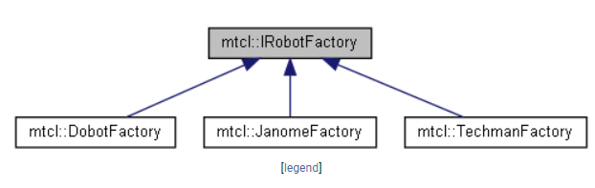
Structure
IRobotFactory: interface of RobotFactory which used to instantiate concrete robot and concrete user control.

Slide 7
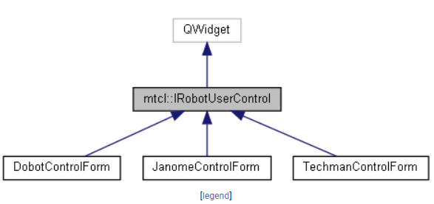
User Control
IRobotUserControl: interface of user control which is one QWidget component.
Each robot has specific user control.

Slide 8
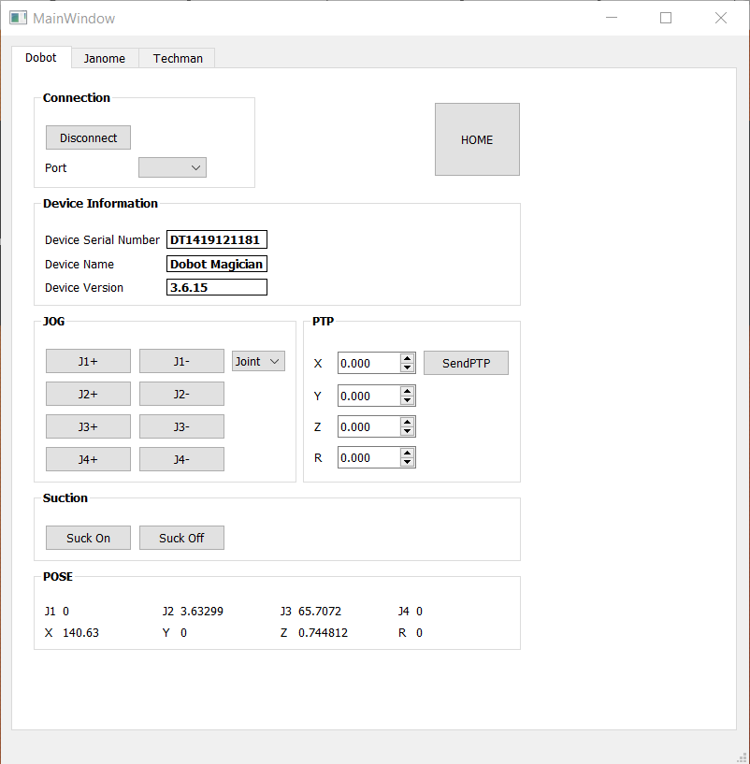
Dobot User Control
Connect to Robot: if connection is established, control buttons are enabled.
Robot information is updated (included Serial Number, Name and Version)
Current position is updated.
User can control robot by using JOG function (with two modes: Joint and Axes) or PTP function
Robot Information
Sucker
Current Position

Slide 9
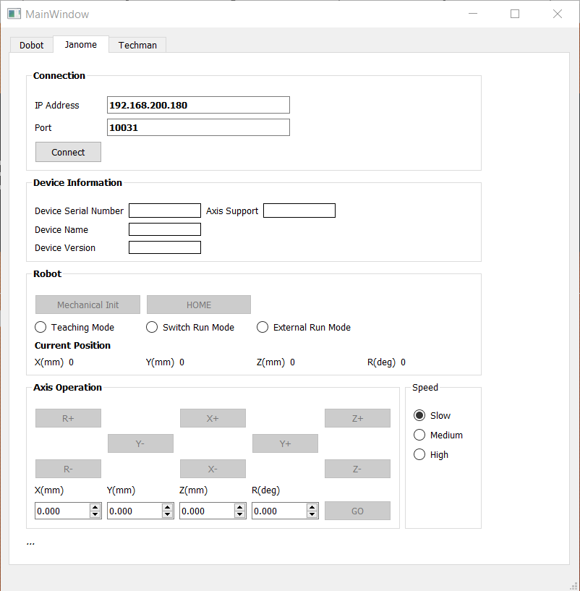
Janome User Control
Connect to robot: if connection is established, control buttons are enabled.
Robot information is updated (included Serial Number, Name, Version and Axis Support)
For very first time, Mechanical Initialize required to process.
If “Mechanical Initialize” processed, user can control the robot by using “JOG” function or PTP function.
Speed level is selected with 03 values (slow, medium and high)
Robot Information
Current Position
JOG
Speed Level
PTP

